Slide 1
DEVIL FACIAL TUMOUR DISEASE:
NOVEL INSIGHTS THROUGH CELL MECHANICS
A BIOPHYSICAL APPROACH
Group 13: Sulagna Nandi, Nam Nguyen, Sara Osman, Ann Maria Philip, Keira Sponagle

Slide 2
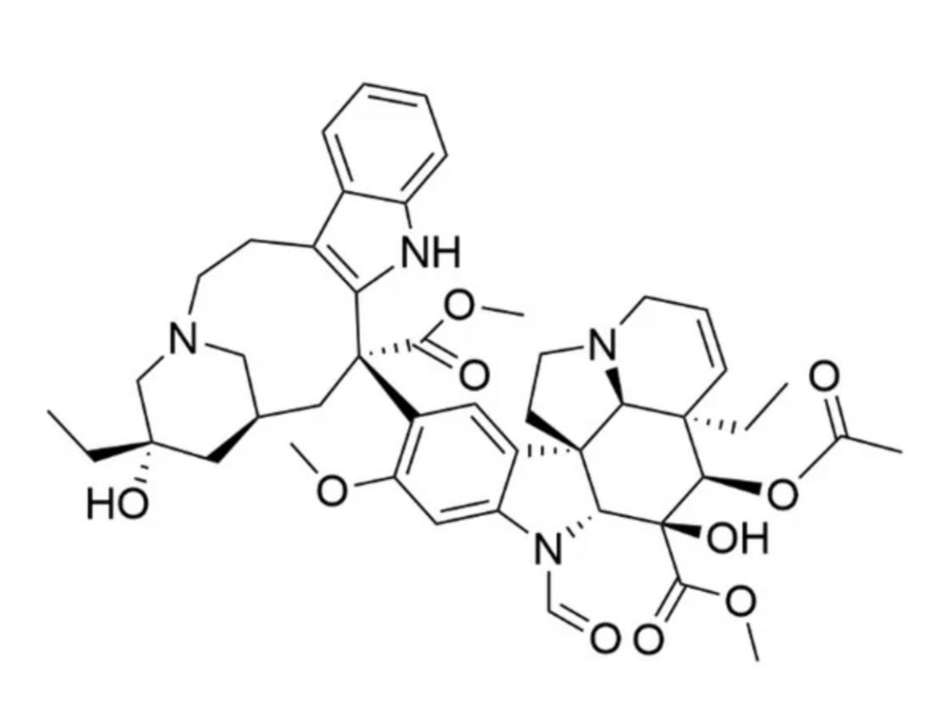
VINCRISTINE
  vinca alkaloid that induces apoptosis
  causes cell cycle arrest in the metaphase
  disrupts microtubules in mitosis phase of cell division and proliferation
(Škubník et al. 2021)

Slide 3
COMPUTATIONAL ANALYSIS USING LINEAR REGRESSION
DFTD WITH AND WITHOUT VINCRISTINE TREATMENT

Slide 4
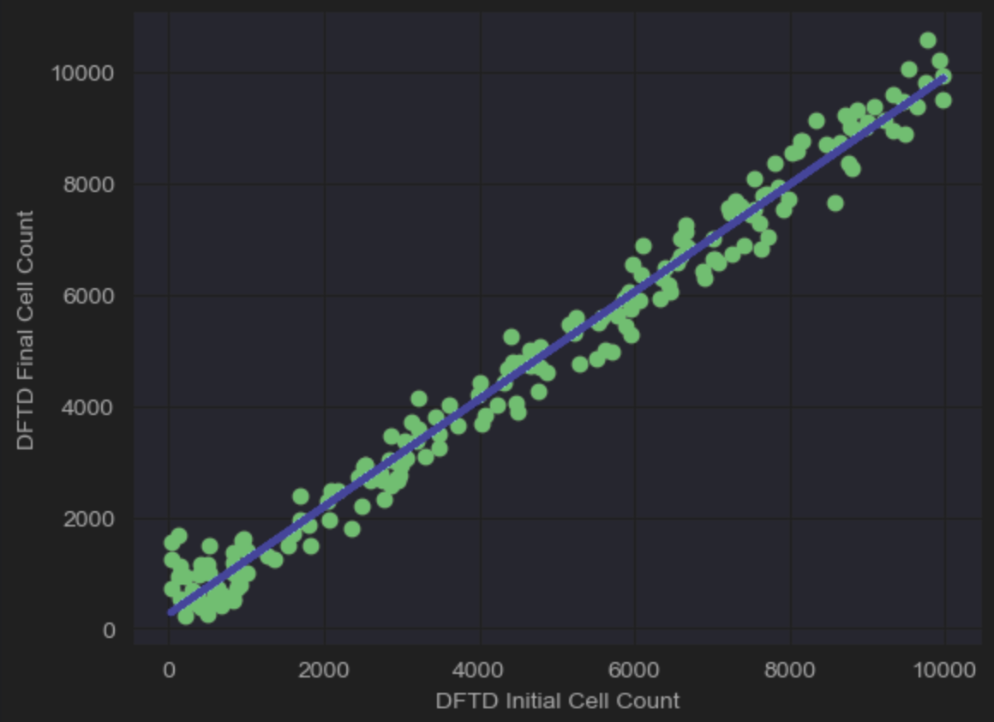

DFTD CELLS WITH VINCRISTINE
REGRESSION LINE:
Y = 0.9638X + 261.4
2
R VALUE:
0.9804

Slide 5
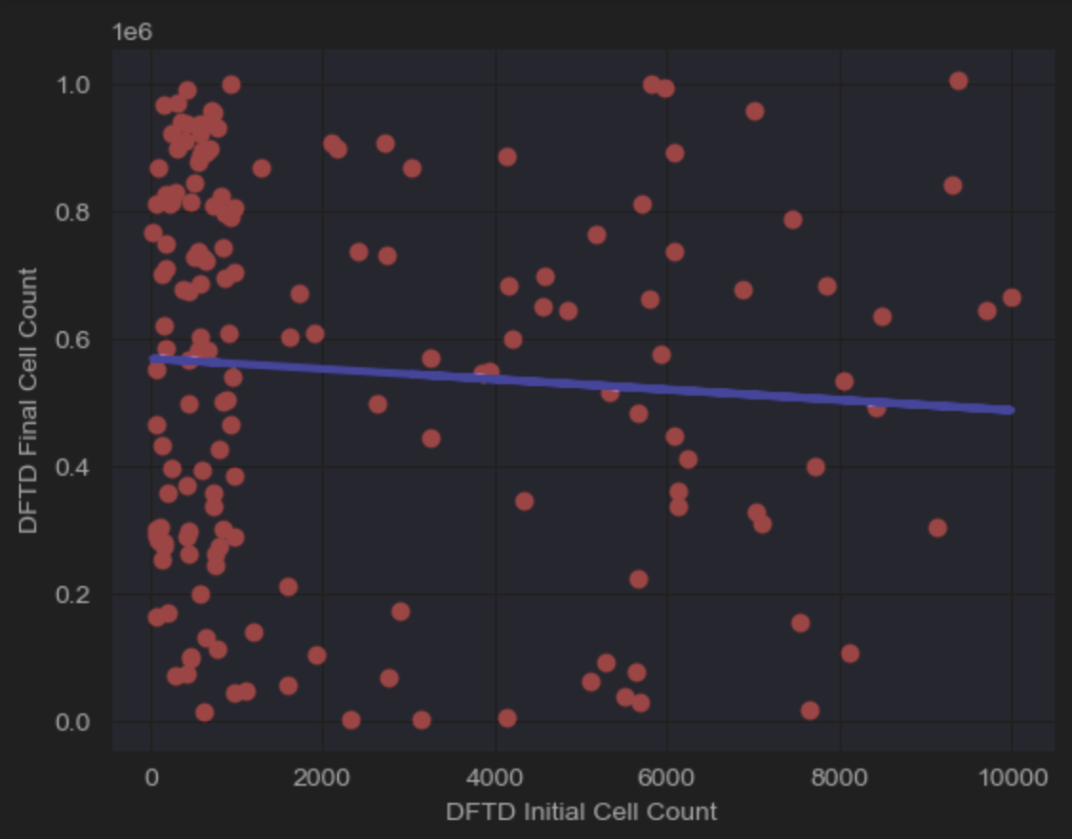
DFTD CELLS WITHOUT VINCRISTINE
REGRESSION LINE:
Y = -8.105X + 569453
R VALUE:
0.0056
2
5

Slide 6
INVESTIGATING SEMI-RESISTANCE
We will examine vincristine’s mechanism of action in order to further investigate the semi-resistance of DFTD cells.
Why is vincristine-induced mitotic arrest not leading to apoptosis?
6

Slide 7
INVESTIGATING SEMI-RESISTANCE
We will examine vincristine’s mechanism of action in order to further investigate the semi-resistance of DFTD cells.
Why is vincristine-induced mitotic arrest not leading to apoptosis?
Evasion of apoptosis is a hallmark of cancer
Cytoskeletal restructuring is a pathway through which cells can evade apoptosis.
7

Slide 8
BIOPHYSICS AND DFTD
The biophysical perspective offers novel insights into DFTD treatment.
Biophysics and cancer research:
  vincristine treatment decreases stiffness in cancer cells
  hypothesized cytoskeletal repair mechanism countering this softening
    repair causes choline metabolism, increasing total choline (tCho) levels
8

Slide 9
BIOPHYSICS AND DFTD
The biophysical perspective offers novel insights into DFTD treatment.
Biophysics and cancer research:
  vincristine treatment decreases stiffness in cancer cells
  hypothesized cytoskeletal repair mechanism countering this softening
    repair causes choline metabolism, increasing total choline (tCho) levels
Our proposed study’s question:
How does vincristine alter cell stiffness in DFT1 cells and what changes in choline metabolism contribute to the cell’s response to vincristine treatment?
9

Slide 10
METHODS OVERVIEW
Atomic Force Microscopy (AFM) Nanoindentation
Magnetic Resonance Spectroscopy (MRS)
TECHNOLOGY
10

Slide 11
METHODS OVERVIEW
Atomic Force Microscopy (AFM) Nanoindentation
Magnetic Resonance Spectroscopy (MRS)
TECHNOLOGY
CELL LINES
DFT1 and human neuroblastoma
11

Slide 12
METHODS OVERVIEW
Atomic Force Microscopy (AFM) Nanoindentation
Magnetic Resonance Spectroscopy (MRS)
TECHNOLOGY
CELL LINES
DFT1 and human neuroblastoma
Apoptosis
Caspase-independent cell death
DURATION
0
6
12
18
24
48
12

Slide 13
METHODS OVERVIEW
Atomic Force Microscopy (AFM) Nanoindentation
Magnetic Resonance Spectroscopy (MRS)
TECHNOLOGY
CELL LINES
DFT1 and human neuroblastoma
Apoptosis
Caspase-independent cell death
DURATION
0
6
12
18
24
48
CONTROLS
Untreated DFT1 and human neuroblastoma experimental groups
13

Slide 14
CELL LINE PREP
DFT1 cell line C5065
Neuroblastoma cell line SH-SY5Y
Pinfold et al. 2014
Kaya et al. 2024
Vincristine administration:
  Continuous exposure
  Based off of Tu et al.
  In glass coverslips (AFM) or culture dishes (MRS)
14

Slide 15
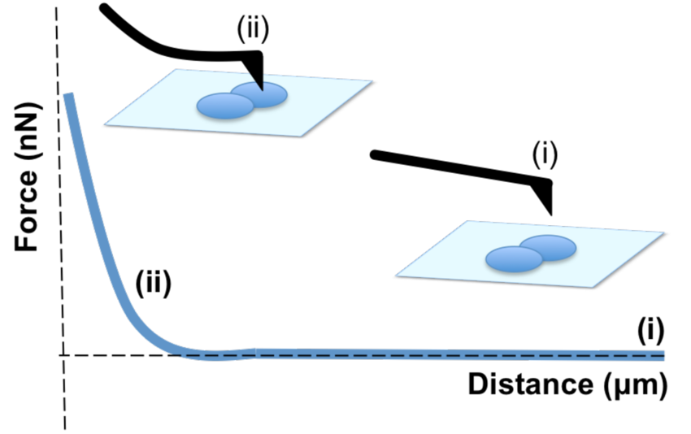
NANOINDENTATION
30 cells per experimental condition
Measured in triplicate
90 force-distance curves per experimental condition
(Aguayo 2016)
15

Slide 16
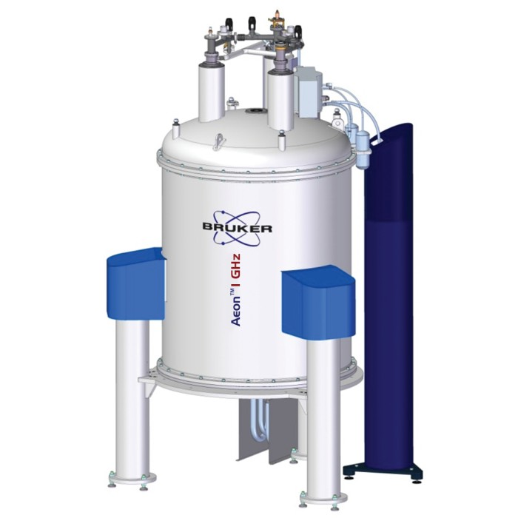
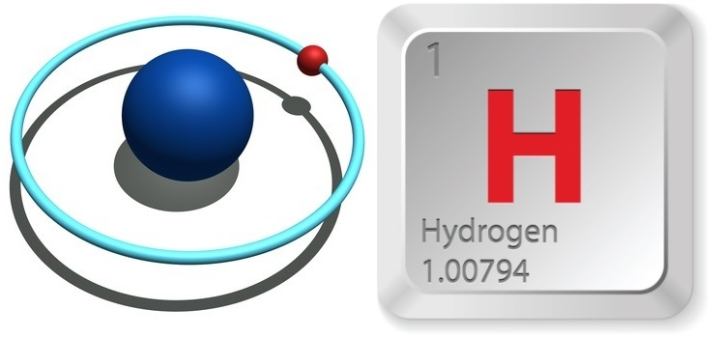
MRS IMAGING OVERVIEW
(Blaszczak-Boxe 2015, Reisch 2015)
16

Slide 17
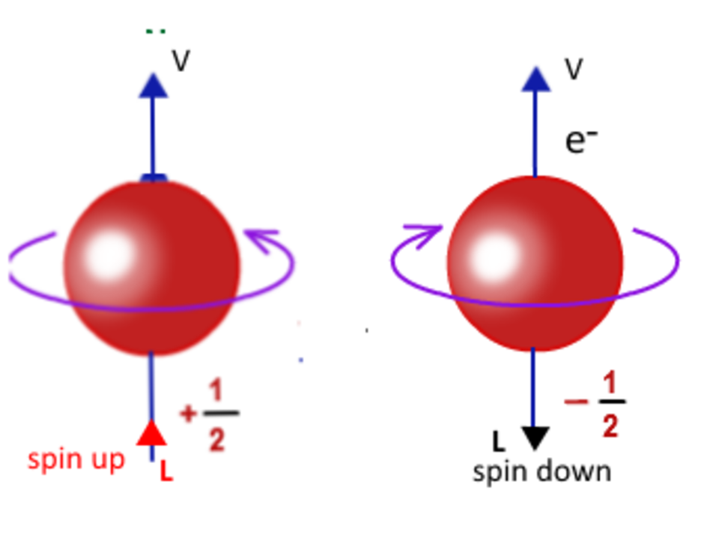
MRS IMAGING OVERVIEW
(Jethro 2025)
17

Slide 18
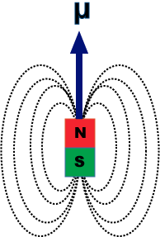
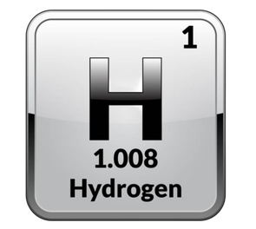
MRS IMAGING OVERVIEW
Magnetic Dipole Moment
18

Slide 19

MRS IMAGING OVERVIEW
NMR/MRS Machine
Sample
(Blaszczak-Boxe 2015)
19

Slide 20
MRS IMAGING OVERVIEW
Magnetic Field
Inside
Sample
Net Polarization
20

Slide 21
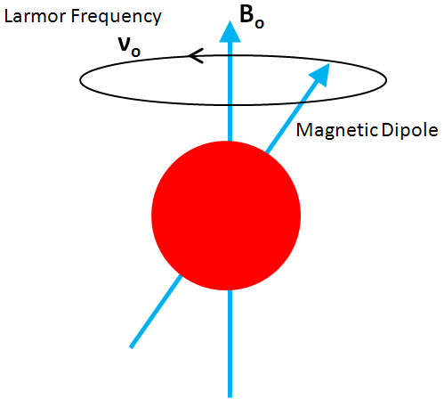

MRS IMAGING OVERVIEW
(Bailey 2019)
21

Slide 22


MRS IMAGING OVERVIEW
22

Slide 23

MRS IMAGING OVERVIEW
Radiowaves
23

Slide 24
MRS IMAGING OVERVIEW
24

Slide 25
MRS IMAGING OVERVIEW
25

Slide 26



MRS IMAGING OVERVIEW
Magnetic Field
26

Slide 27

MRS IMAGING OVERVIEW
Magnetic Field
27

Slide 28
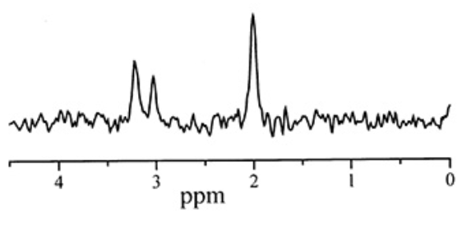
MRS IMAGING OVERVIEW
(Robertson and Cox)
28

Slide 29
MRS IMAGING : TOTAL CHOLINE
29

Slide 30
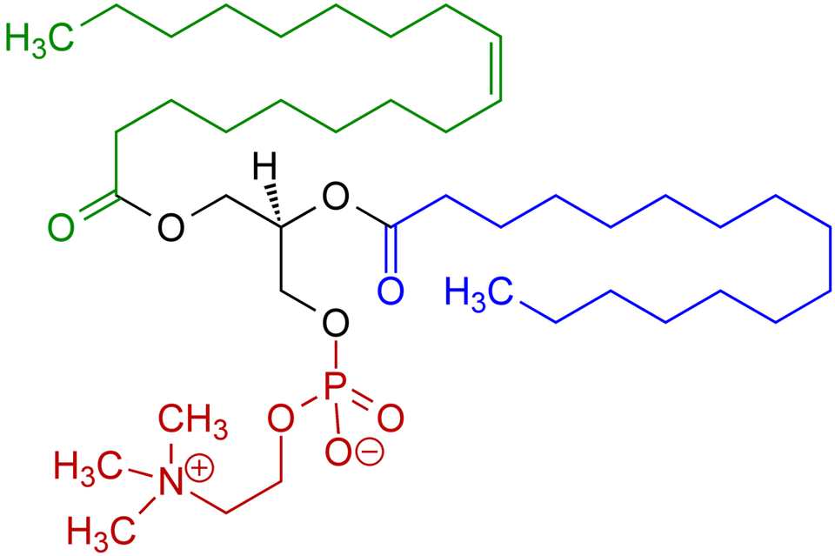
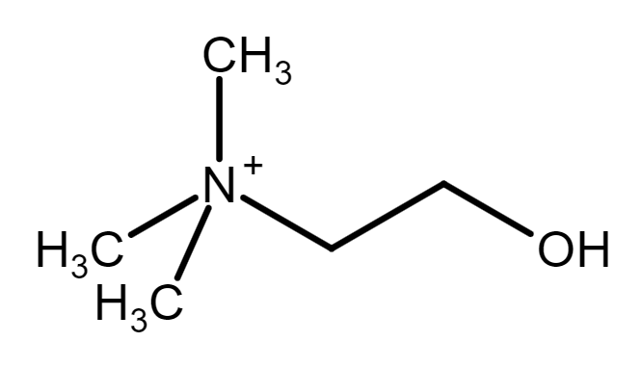
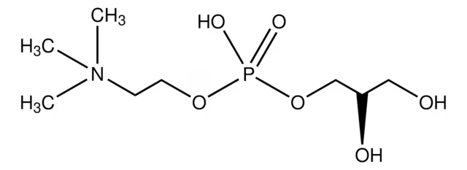
MRS IMAGING : TOTAL CHOLINE
Choline (Cho)
Phosphatidylcholine (pCho)
Glycerophosphorylcholine (gCho)
(Sigma-Aldrich)
30

Slide 31
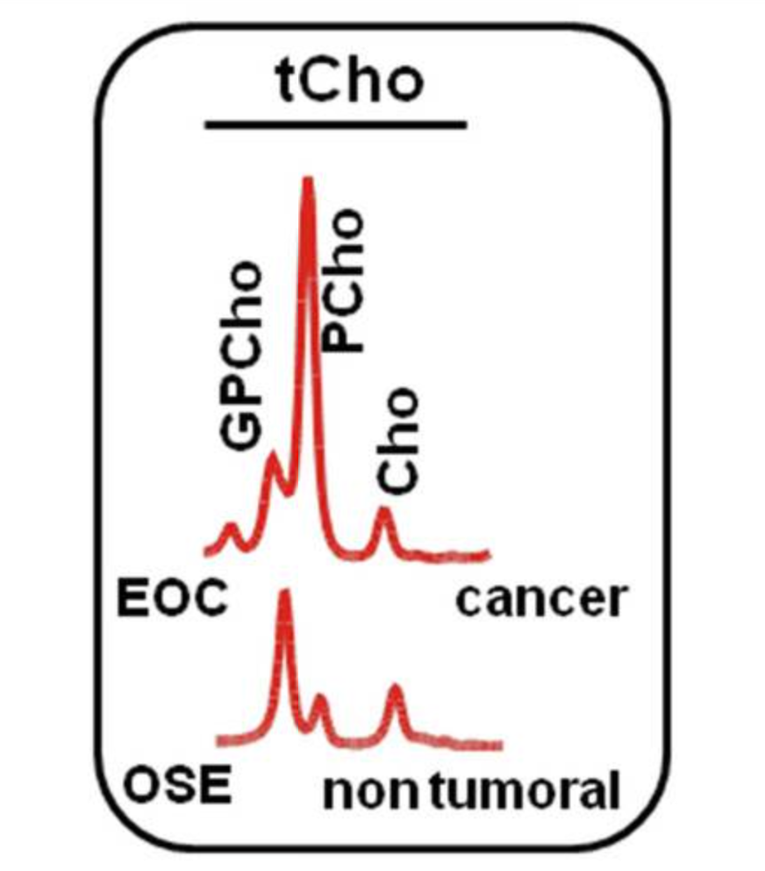
MRS IMAGING : TOTAL CHOLINE
(Iorio et al. 2021)
31

Slide 32
OUTCOMES
Cell stiffness
tCho level
Interpretation
Future endeavors
Decrease
Increase
No change
Increase
Adaptive response
Time-targeted combination therapy
Increase
Increase
32

Slide 33
CONCLUSIONS
Novel biophysical perspective, contributing to our understanding of:
Hallmarks of cancer
Possibility of combination therapies
Cell mechanics in cancers without clear treatment options
33

Slide 34
QUESTIONS?
34

Slide 35
COLLECTED DATA
Treated DFT1
30 cells
3 locations
Treated neuroblastoma
30 cells
3 locations
AFM measurements: 6 time marks
Untreated DFT1
30 cells
3 locations
Untreated neuroblastoma
30 cells
3 locations
Treated DFT1
12 samples
Treated neuroblastoma
12 samples
MRS measurements: 6 time marks
Untreated DFT1
12 samples
Untreated neuroblastoma
12 samples
35
35

Slide 36
COLLECTED DATA
720 comparative stiffness values
AFM measurements:
288 comparative tCho values
MRS measurements:

Slide 37
OUTCOMES
Interpretations of combined cell stiffness (AFM) and tCho level (MRS) findings.
MRS | No change | Increase | Decrease
No change | Complete resistance | Metabolic adaptation | Signs of stress
Increase | Alternate resistance | Resistance and compensation | Inconclusive
Decrease | Destabilization without response | Destabilization with response | Successful treatment
AFM
37

Slide 38
THANK YOU
38

